Slide 1

PREDICTION OF HEART DISEASE USING FUZZY LOGIC
Guided By
Dr. K. Ramkumar , Professor-EIE
Electronics And Instrumentation Engineering
SASTRA DEEMED TO BE UNIVERSITY
Thanjavur - 613401.
Presented by
Annapoorani J -121006095
Electronics And Instrumentation Engineering
SASTRA DEEMED TO BE UNIVERSITY
Thanjavur - 613401.

Slide 2
INDEX
→ Introduction
→ literature survey
→Methods and materials
→ Rules followed
→Code and discussion
→ References

Slide 3
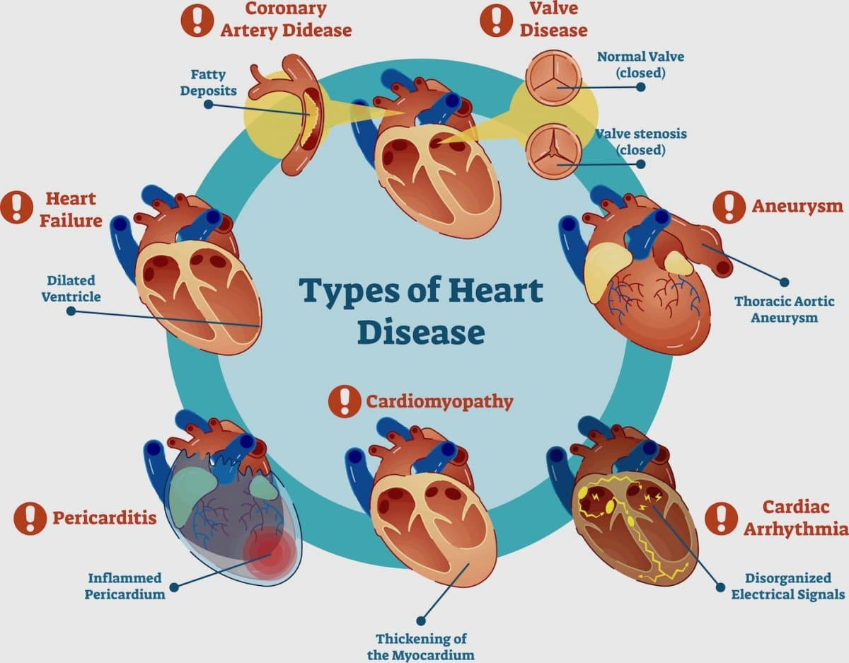
INTRODUCTION
Cardiovascular diseases
Cardiovascular diseases (CVDs) are the number 1 cause of death globally, taking an estimated 17.9 million lives each year.
Heart disease includes,
Coronary Artery Disease (CAD)
Heart Arrhythmias.
Heart Failure.
Heart Valve Disease.
Pericardial Disease.
Cardiomyopathy (Heart Muscle Disease)
Congenital Heart Disease.
.
(1)
(1)

Slide 4
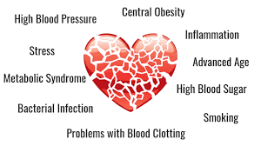
Causes of heart disease
There are many causes of heart disease. some of the major causes of heart disease are listed below:
Higher levels of blood pressure
Family history
Higher levels of cholesterol
Improper sugar levels
Physical inactivity
Bacterial infection
Other risk factors such as age,diet,gender etc.
(2)

Slide 5
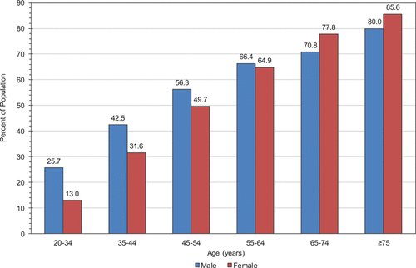
Survey of heart disease in recent years
(3)
Source: World Health Organization
According to the data given by the World Health Organization about 17.9 million people die due to heart disease which is equivalent to 31% of deaths that occur worldwide in the year 2016.

Slide 6

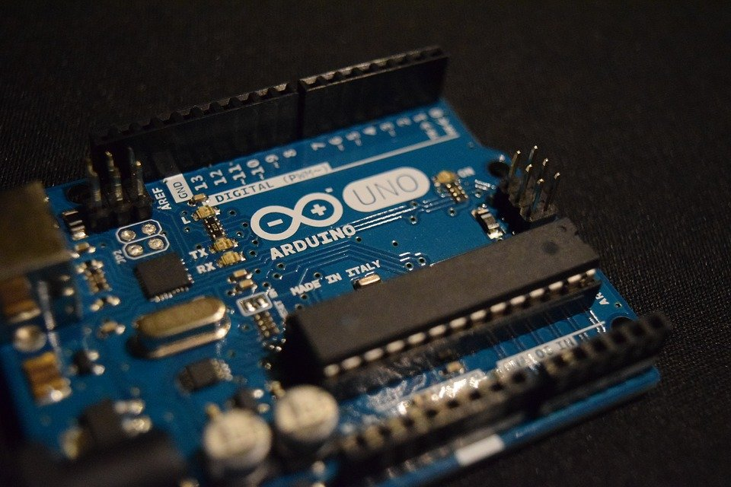
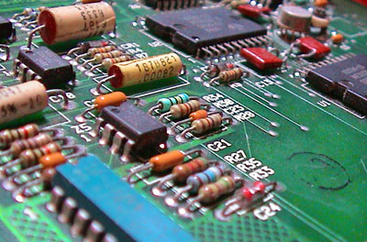
FUZZY LOGIC
Fuzzy logic is a generalization of standard logic, in which a concept can possess a degree of truth anywhere between 0.0 and 1.0.
Standard logic applies only to concepts that are completely true (having degree of truth 1.0) or completely false (having degree of truth 0.0).
Fuzzy logic is supposed to be used for reasoning about concepts which are not clear, such as 'tallness.'

Slide 7
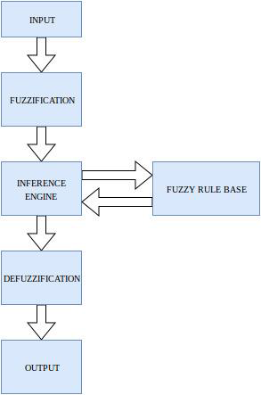
Fuzzy System Block diagram

Slide 8
Literature survey
Authors | Title | Control strategies
Asadi et al.[1] | Random forest swarm optimization-based for heart diseases diagnosis | Random Forest and multi-objective particle swarm optimization (MOPSO) which is a new approach for the prediction of heart disease in the patient
Ali et al.[2] | A smart healthcare monitoring system for heart disease prediction based on ensemble deep learning and feature fusion. | smart method for prediction of heart disease using ensemble deep learning and the feature fusion approaches
Mohan et al.[3] | Effective heart disease prediction using hybrid machine learning techniques | Enhanced performance level of prediction with an accuracy of upto 88.7% with the help of the model called hybrid random forest with a linear model (HRFLM)

Slide 9
Literature survey
Authors | Title | Control strategies
Repaka et al.[4] | Design and implement heart disease prediction using naives Bayesian | Advanced Encryption Algorithm for the prediction of the factors and risk of heart disease
Maji et al.[5] | Decision tree algorithms for prediction of heart disease | Hybridization technique is introduced in which artificial neural network classifiers and decision tree are hybridized for enhanced performance of the prediction of heart disease
Kouser et al.[6] | Heart disease prediction system using artificial neural network, radial basis function and case based reasoning | Authors used two methodologies namely the Artificial neural network(ANN) by testing the input datasets and Case Based Reasoning(CBR) image similarity search by mapping the closeness of images of previous patients saved in database for the prediction of heart disease

Slide 10
Literature survey
Authors | Title | Control strategies
Shanmugasundaramet al.[7] | An Investigation of Heart Disease Prediction Techniques | Data mining techniques such as K-nearest neighbor, Decision Tree, etc, used in the prediction of heart disease based on the input factors
Mathan et al.[8] | A novel Gini index decision tree data mining method with neural network classifiers for prediction of heart disease | Decision tree data mining method for the prediction of heart disease
Rairikar et al.[9] | Heart disease prediction using data mining techniques | Genetic algorithm with the help of back propagation approach for the prediction of the heart disease
Kowsigan et al.[10] | Heart Disease Prediction by analysing various parameters using fuzzy logic | Fuzzy logic using the matlab platform for the prediction of heart disease

Slide 11
METHODS AND MATERIALS
The system has five input attributes and one output attribute which gives the percentile chances of getting heart disease.
The five major factors that are considered in model are as follows:
Blood pressure
Systolic
Diastolic
High density lipoprotein(HDP)
Low density lipoprotein(LDP)
Triglycerides
Some of the other factors also include family history, physical inactivity, alcohol etc.
In the levels of blood pressure there are two subdivisions that are systolic and diastolic, In these there are three categories ,those are normal, risk and high. The ranges of the membership function is as follows,

Slide 12
Fuzzy set | Range Systolic | Range Diastolic
Normal | <120mmHg | <80mmHg
Medium | 120-189mmHg | 80-89mmHg
High | >140mmHg | >90mmHg
TABLE -I: .BLOOD PRESSURE LEVELS
TABLE II.HIGH DENSITY LIPOPROTEIN
Fuzzy set | Range
<40 | Low
40-59 | Normal
>40 | Best

Slide 13
Fuzzy set | Range
<150 | Low
150 - 499 | Normal
>500 | Best
TABLE - III: TRIGLYCERIDES RANGE
Fuzzy set | Range
<100 | Normal
100-130 | Close to normal
130-160 | Close to high
160-190 | Maximum
>190 | Over Maximum
TABLE-IV: LOW DENSITY LIPOPROTEIN

Slide 14
RULES FOLLOWED
The accuracy and quality of the fuzzy systems completely depends on the rules that are designed for the system. Here I have used 20 rules for designing my system. The rules are as follows
When LDP is very minimum and HDP is high ,triglycerides is minimum, systolic level is minimum and diastolic level is minimum – chances of getting heart disease is very low.
When LDP is minimum , HDP is high , triglycerides is minimum, systolic level is minimum and diastolic level is minimum –chances of getting heart disease is very low.
When LDP is nearly high , HDP is high , triglycerides is minimum , systolic level is minimum and diastolic level is minimum – chances of getting heart disease is medium.
When LDP is high , HDP is high , triglycerides is minimum, systolic level is minimum and diastolic level is minimum –chances of getting heart disease is medium.
When LDP is very high, HDP is high, triglycerides is minimum, systolic level is minimum and diastolic level is minimum – chances of getting heart disease is medium.
When LDP is very minimum, HDP is moderate, triglycerides is minimum , systolic level is minimum and diastolic level is minimum – chances of getting heart disease is medium.
When LDP is very minimum , HDP is minimum, triglycerides is minimum, systolic level is minimum and diastolic level is minimum – chances of getting heart disease is medium.

Slide 15
RULES FOLLOWED
When LDP is very minimum, HDP is minimum, triglycerides is high, systolic level is minimum and diastolic level is minimum – heart disease is chance to occur.chances of getting heart disease is medium.
When LDP is very minimum, HDP is minimum, triglycerides is very high, systolic level is minimum and diastolic level is minimum –chances of getting heart disease is high.
When LDP is very minimum , HDP is minimum , triglycerides is very high, systolic level is average and diastolic level is minimum – chances of getting heart disease is high.
When LDP is very minimum, HDP is minimum, triglycerides is very high, systolic level is high and diastolic level is minimum –chances of getting heart disease is high.
When LDP is very minimum, HDP is minimum, triglycerides is very high, systolic level is minimum and diastolic level is minimum – chances of getting heart disease is high
When LDP is very minimum, HDP is minimum, triglycerides is very high, systolic level is very high and diastolic level is high – chances of getting heart disease is medium.
When LDP is very minimum, HDP is minimum, triglycerides is very high , systolic level is high and diastolic level is very high – chances of getting heart disease is low.

Slide 16
RULES FOLLOWED
When LDP is minimum , HDP is high , triglycerides is minimum, systolic level is very high and diastolic level is minimum – chances of getting heart disease is low.
When LDP is very minimum, HDP is moderate, triglycerides is minimum , systolic level is minimum and diastolic level is minimum – chances of getting heart disease is low.
When LDP is very minimum, HDP is moderate, triglycerides is minimum, systolic level is minimum and diastolic level is minimum – chances of getting heart disease is medium.
When LDP is minimum, HDP is moderate, triglycerides is medium, systolic level is minimum and diastolic level is minimum – chances of getting heart disease is low.
When LDP is high , HDP is high, triglycerides is high and systolic level is minimum and diastolic level is minimum – chances of getting heart disease is high.
When LDP is high , HDP is high , triglycerides is high, systolic level is high and diastolic level is high – chances of getting heart disease is high

Slide 17
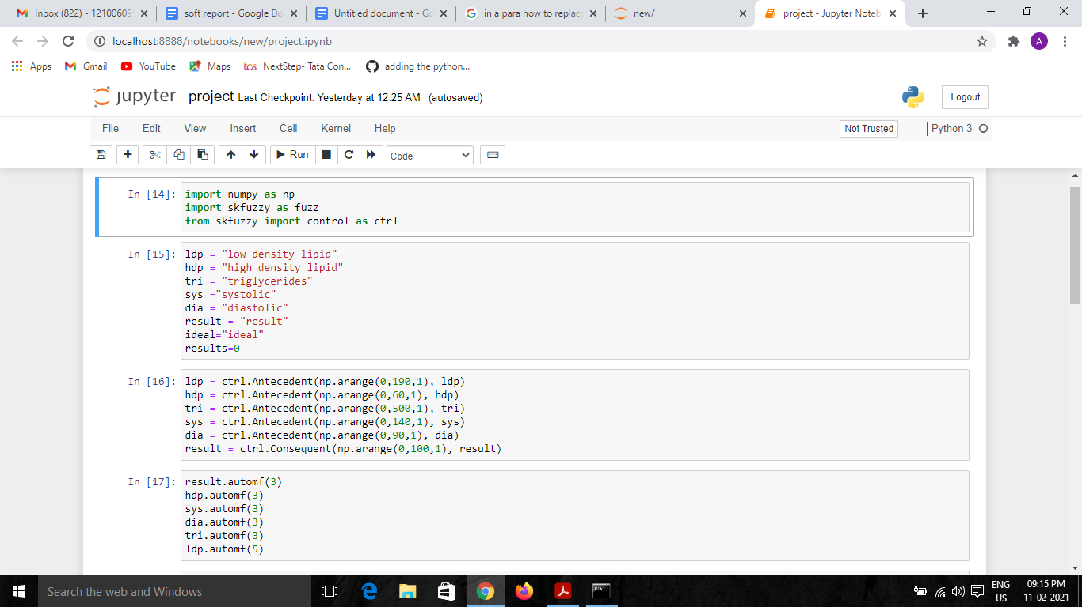
CODE AND DISCUSSION
The fuzzy logic code for heart disease prediction is as follows and it is carried out in jupyter notebook

Slide 18
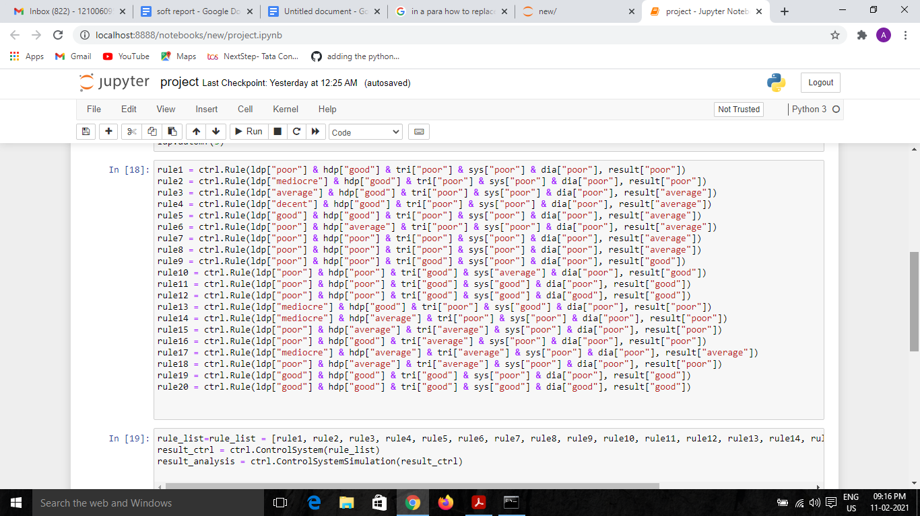
CODE AND DISCUSSION

Slide 19
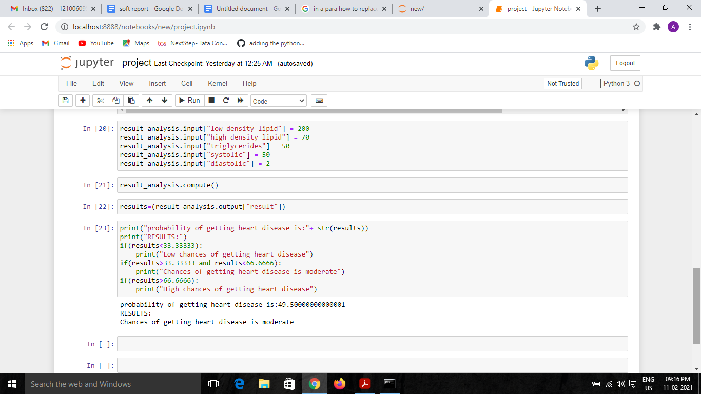
CODE AND DISCUSSION
from the above code we can see one of the example where the LDP is 200, HDP is 70, triglyceride is 50 , systolic is 50 and diastolic is 2 which gives a percentile of getting heart disease as 49.5% which concludes a result of getting cancer is moderate. Likewise we can categorise as lower , moderate and higher chances of getting heart disease.

Slide 20
REFERENCES
[1]:Asadi, Shahrokh, SeyedEhsan Roshan, and Michael W. Kattan. "Random forest swarm optimization-based for heart diseases diagnosis." Journal of Biomedical Informatics (2021): 103690.
[2]: Ali, Farman, et al. "A smart healthcare monitoring system for heart disease prediction based on ensemble deep learning and feature fusion." Information Fusion 63 (2020): 208-222.
[3]: Mohan, Senthilkumar, Chandrasegar Thirumalai, and Gautam Srivastava. "Effective heart disease prediction using hybrid machine learning techniques." IEEE Access 7 (2019): 81542-81554.
[4]:Repaka, Anjan Nikhil, Sai Deepak Ravikanti, and Ramya G. Franklin. "Design and implement heart disease prediction using naives Bayesian." 2019 3rd International Conference on Trends in Electronics and Informatics (ICOEI). IEEE, 2019.
[5]: Maji, Srabanti, and Srishti Arora. "Decision tree algorithms for prediction of heart disease." Information and communication technology for competitive strategies. Springer, Singapore, 2019. 447-454.
[6]: Kouser, R. Ruhin, T. Manikandan, and V. Vinoth Kumar. "Heart disease prediction system using artificial neural network, radial basis function and case based reasoning." Journal of Computational and Theoretical Nanoscience 15.9-10 (2018): 2810-2817.
[7]: Shanmugasundaram, G., et al. "An Investigation of Heart Disease Prediction Techniques." 2018 IEEE International Conference on System, Computation, Automation and Networking (ICSCA). IEEE, 2018.

Slide 21
REFERENCES
[8]: Mathan, K., et al. "A novel Gini index decision tree data mining method with neural network classifiers for prediction of heart disease." Design automation for embedded systems 22.3 (2018): 225-242.
[9]:Rairikar, Abhishek, et al. "Heart disease prediction using data mining techniques." 2017 International Conference on Intelligent Computing and Control (I2C2). IEEE, 2017.
[10]: Kowsigan, M., et al. "Heart Disease Prediction by analysing various parameters using fuzzy logic." Pak. J. Biotechnol 14.2 (2017): 157-161.

